Slide 1



UNIT 5; Tick tock
Lesson 1; Time management

Slide 2
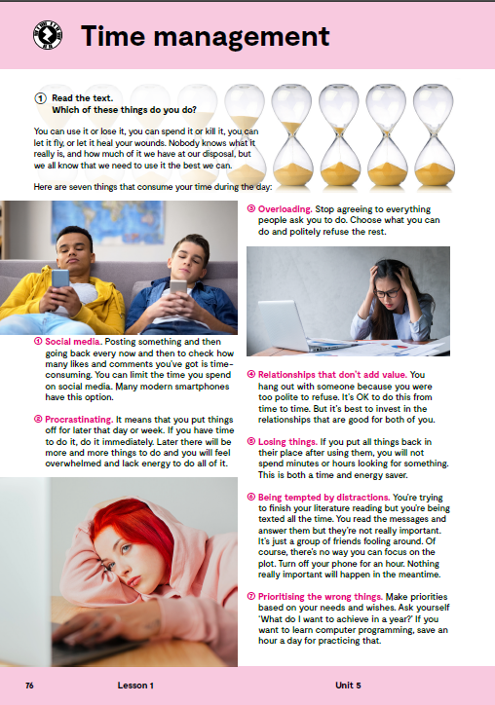
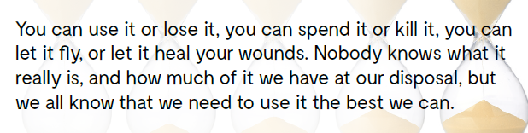
Solve this riddle. What is it? You can use it or lose it, you can spend it or kill it, you can let it fly, or let it heal your wounds. Nobody knows what it really is, and how much of it we have at our disposal, but we all know that we need to use it the best we can.
IT’S TIME.

Slide 3

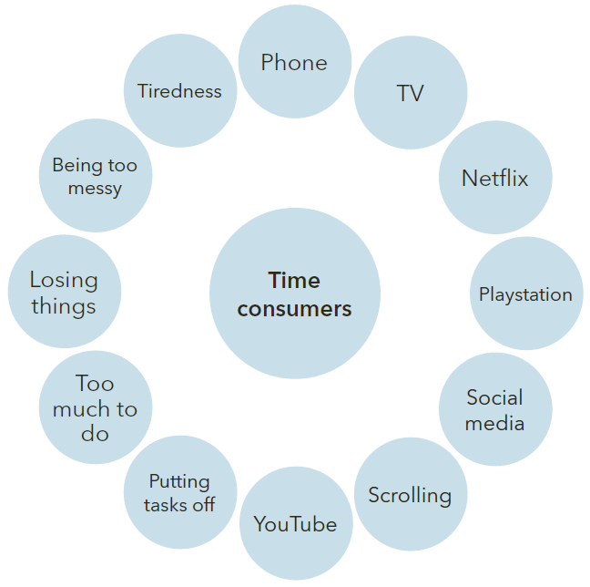
Which of these are the biggest time consumers? You can also add your thoughts.

Slide 4

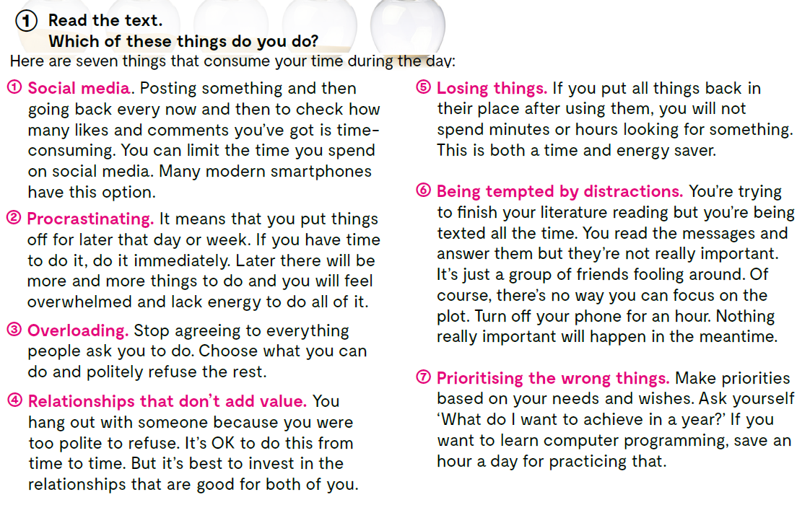
Read the text. Which of these things do you do? Here are seven things that consume your time during the day.

Slide 5
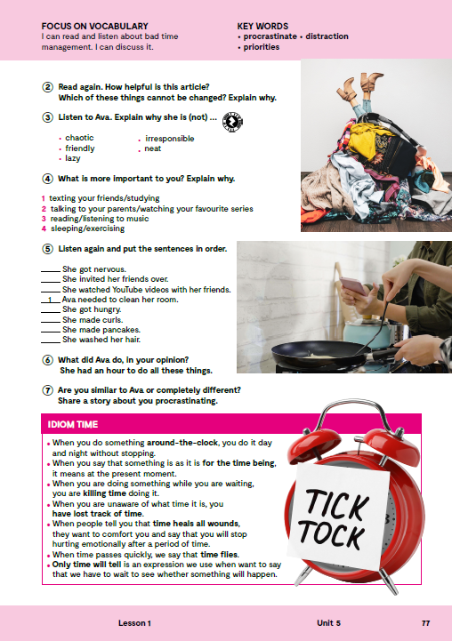

Read again. How helpful is this article? Which of these things cannot be changed? Explain why.

Slide 6
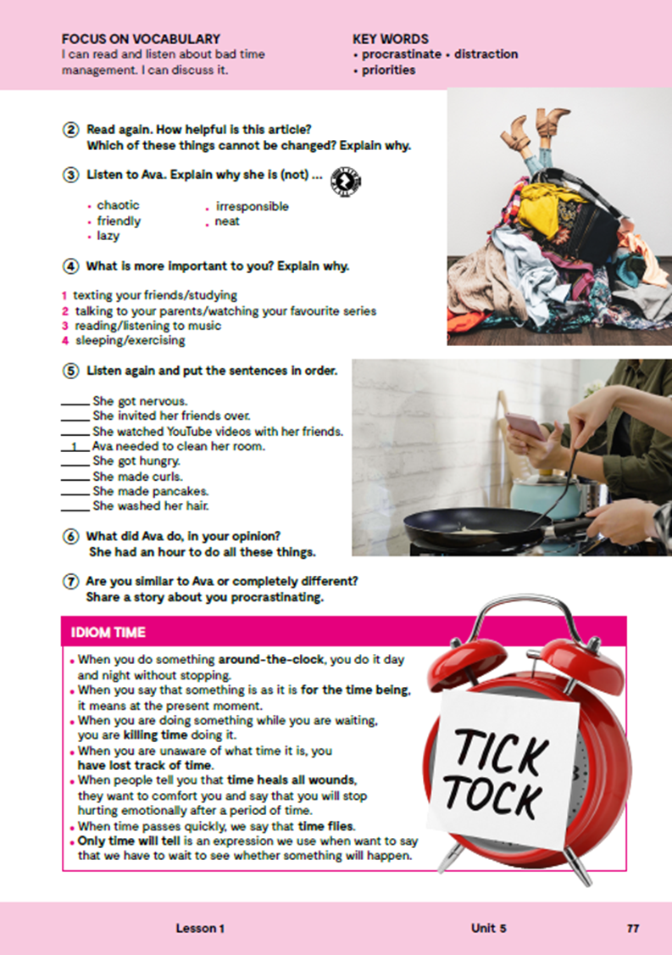
Do these questions apply to you? Choose the appropriate number from 0 to 4. (0 = never; 1 = rarely; 2 = sometimes; 3 = often; 4 = always). 1 Do you post something and then go back and forth to check likes and comments? 2 Do you put off tasks for later? 3 Do you agree to everything people ask you to do? 4 Do you hang out with people just to be polite to them? 5 Do you lose things? 6 Do you immediately reply to unimportant messages? 7 Do you prioritise based on your needs and wishes? You can do this online. http://www.supersurvey.com/Q09RUITYO
What are the time management challenges and the solutions to that challenges?

Slide 7
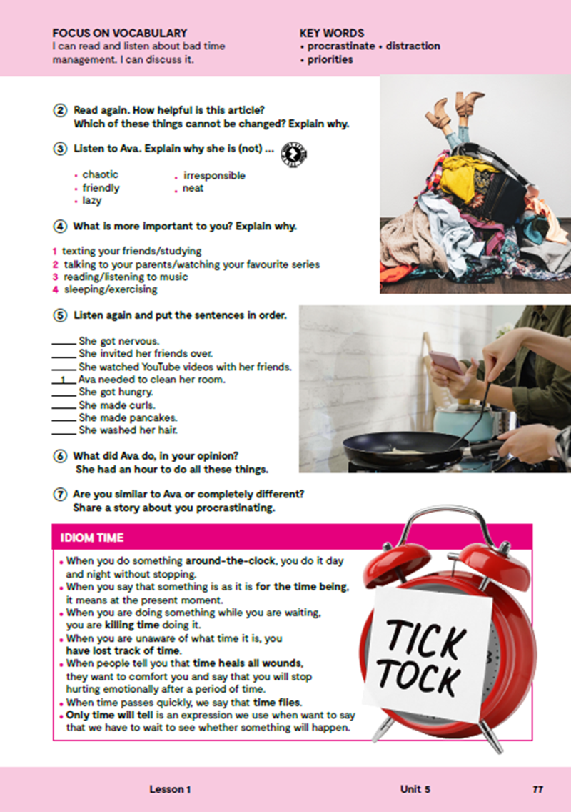
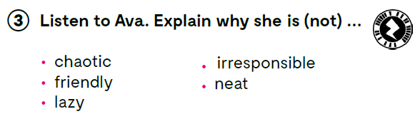

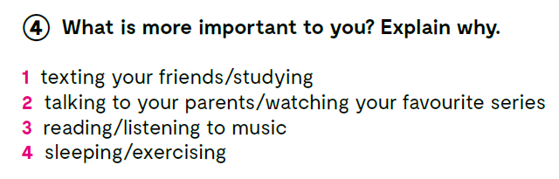
Listen to Ava. Explain why she is (not)… chaotic, friendly, lazy, irresponsible, neat. https://www.e-sfera.hr/dodatni-digitalni-sadrzaji/b7437da4-6c10-4813-92ea-53b3186ba1b7/assets/audio/16_unit_5__lesson_1__exercise_3_5.mp3
Pick one of the time consuming things in your life and try to think of the solution. .
Do you have people in your life who are chaotic, friendly, lazy, irresponsible, neat?
What is more important to you? Why?.

Slide 8
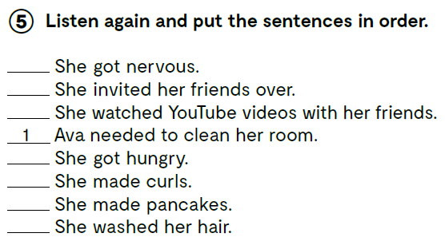


8
Listen again and put the sentences in order. https://www.e-sfera.hr/dodatni-digitalni-sadrzaji/b7437da4-6c10-4813-92ea-53b3186ba1b7/assets/audio/16_unit_5__lesson_1__exercise_3_5.mp3
6
7
4
3
5
2
What did Ava do, in your opinion? She had an hour to do all these things.
Are you similar to Ava or completely different? Share a story about you procrastinating.

Slide 9

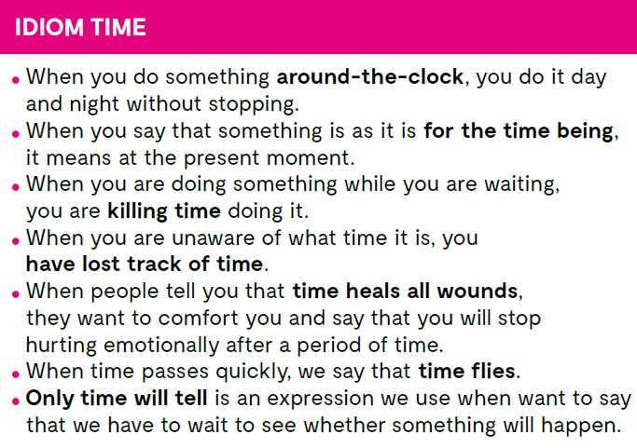
Check what you have learnt. https://www.bookwidgets.com/play/ZCAB7ZT

Slide 10
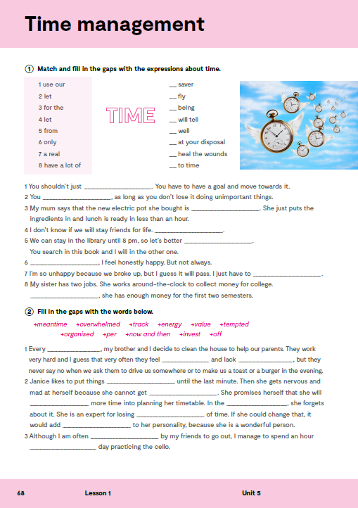
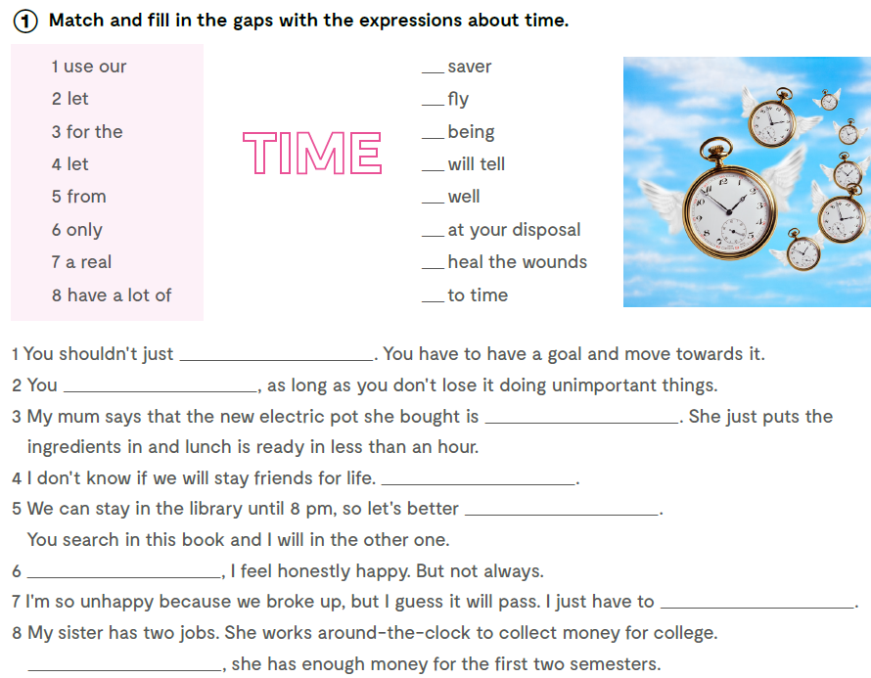
Open your exercise book, page 68.
7
4
3
6
Match and fill in the gaps with the expressions about time.
1
8
2
5
let time fly
have a lot of time at your disposal
a real time saver
Time will tell
use our time well
From time to time
let time heal the wounds
For the time being

Slide 11
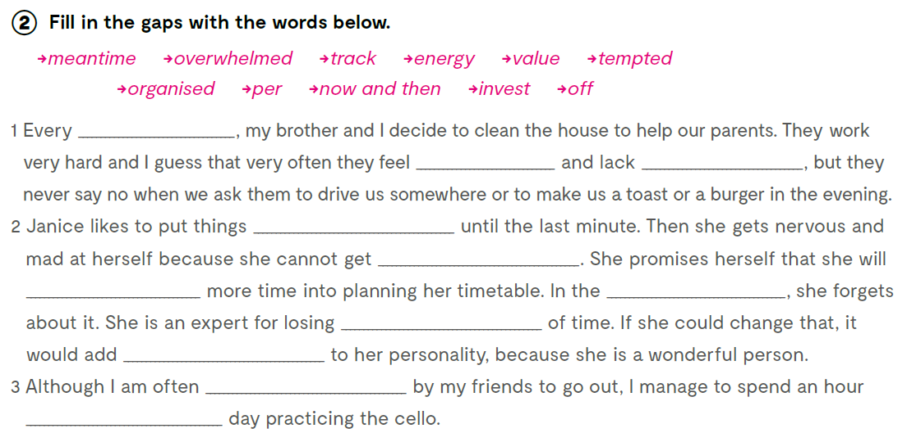
Finish the sentences with the words below.
now and then
overwhelmed
energy
off
organised
invest
meantime
track
value
tempted
per

Slide 12
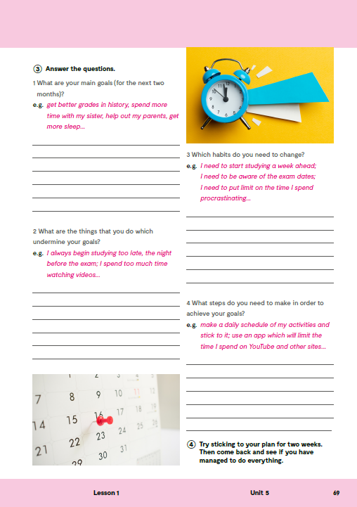
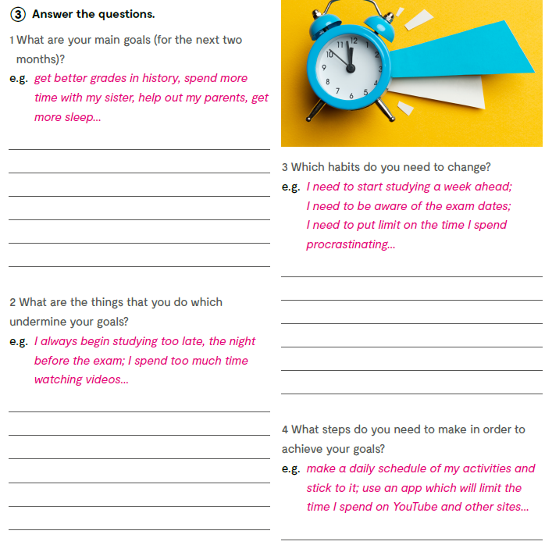
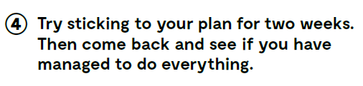
On the next page, page 69.
Answer the questions.

